Slide 1
Quant Week 3
Factor Pricing Models

Slide 2
Lecture Outline
Linear Factor Pricing Models
The CAPM
Multi Factor Models
Fama-French Model

Slide 3
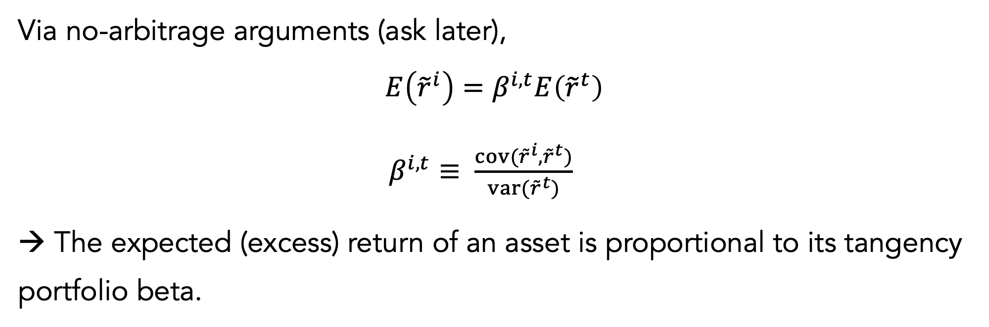
Factor pricing
Via no-arbitrage arguments (ask later),
$$E\left({\tilde{r}}^{i}\right)=β^{i, t}E\left({\tilde{r}}^{t}\right)$$
$β^{i,t}≡ \frac{cov({\tilde{r}}^{i},{\tilde{r}}^{t})}{var({\tilde{r}}^{t})}$
→ The expected (excess) return of an asset is proportional to its tangency portfolio beta.

Slide 4
Linear factor pricing models (LFPM)
LFPMs are assertions about the identity of the tangency portfolio, allowing us to avoid the problems of direct estimation, relying on assumptions about the identity of the tangency portfolio.

Slide 5
Allocation vs. Pricing
The theory doesn’t assume investors allocate to this M-V portfolio:
It assumes MV for the portfolio in order to price expected returns
Also assuming investors prefer MV means that this portfolio will price securities and be the equilibrium allocation
However, even if you don’t want to hold a MV portfolio, all E(r)s are calculated as covariances to the MV portfolio. 👍

Slide 6
Lecture Outline
Linear Factor Pricing Models
The CAPM
Multi Factor Models
Fama-French Model

Slide 7
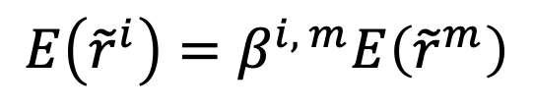
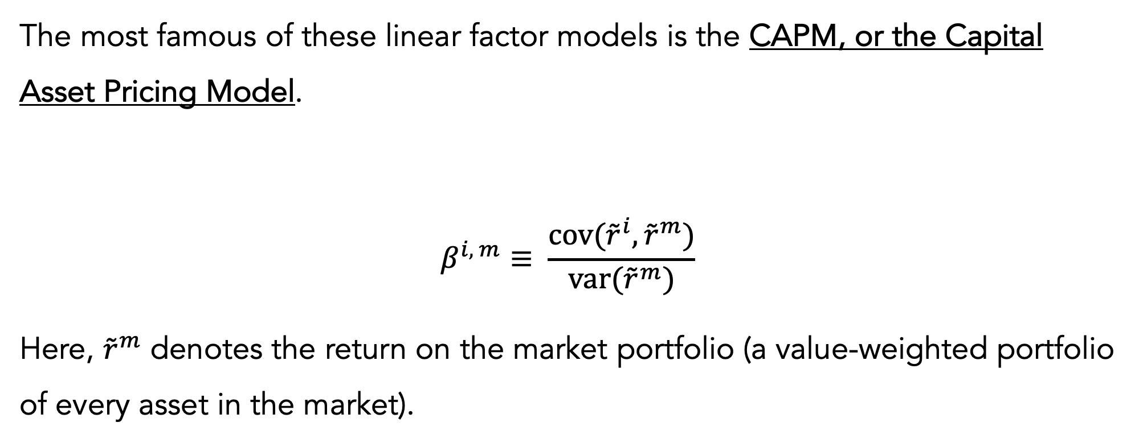
The CAPM
The most famous of these linear factor models is the CAPM, or the Capital Asset Pricing Model.
$$β^{i, m}≡ \frac{cov({\tilde{r}}^{i},{\tilde{r}}^{m})}{var({\tilde{r}}^{m})}$$
Here, ${\tilde{r}}^{m}$ denotes the return on the market portfolio (a value-weighted portfolio of every asset in the market).
$$E\left({\tilde{r}}^{i}\right)=β^{i, m}E\left({\tilde{r}}^{m}\right)$$

Slide 8
The market portfolio
CAPM identifies the market portfolio as the tangency portfolio.
Market portfolio is the value-weighted portfolio of all available assets
In practice, a broad equity index like SPY is generally used

Slide 9
Expected returns
The CAPM tells you about expected returns:
→ E(r) for any asset is a function of the risk-free rate and the market risk premium.
Beta is determined using a regression. CAPM doesn’t tell you how the risk-free rate or market risk premium are given.
CAPM is a relative pricing formula.

Slide 10
Deriving the CAPM (very briefly)
If returns have a joint normal distribution, every investor holds a portfolio on the MV frontier (a combination of the tangency portfolio and the risk-free rate
Thus the market portfolio = the tangency portfolio when you aggregate
Even if returns aren’t normally distributed, mean and variance are sufficient in determining investor objectives, so investors still choose MV portfolios
So one derivation is about return distribution, and the other is about investor behavior (more intuitive)

Slide 11
The role of beta
The CAPM says that the market beta is the only risk associated with higher average returns.
No other characteristics of asset returns lead to higher risk premia for investors
CAPM also says volatility and other covariances do not matter for determining risk premia.

Slide 12
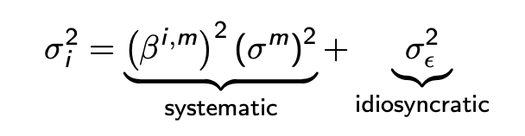
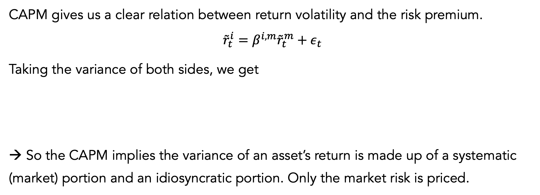
Return variance decomposition
CAPM gives us a clear relation between return volatility and the risk premium.
$${\tilde{r}}_{t}^{i}=β^{i, m}{\tilde{r}}_{t}^{m}+ε_{t}$$
Taking the variance of both sides, we get
→ So the CAPM implies the variance of an asset’s return is made up of a systematic (market) portion and an idiosyncratic portion. Only the market risk is priced.

Slide 13
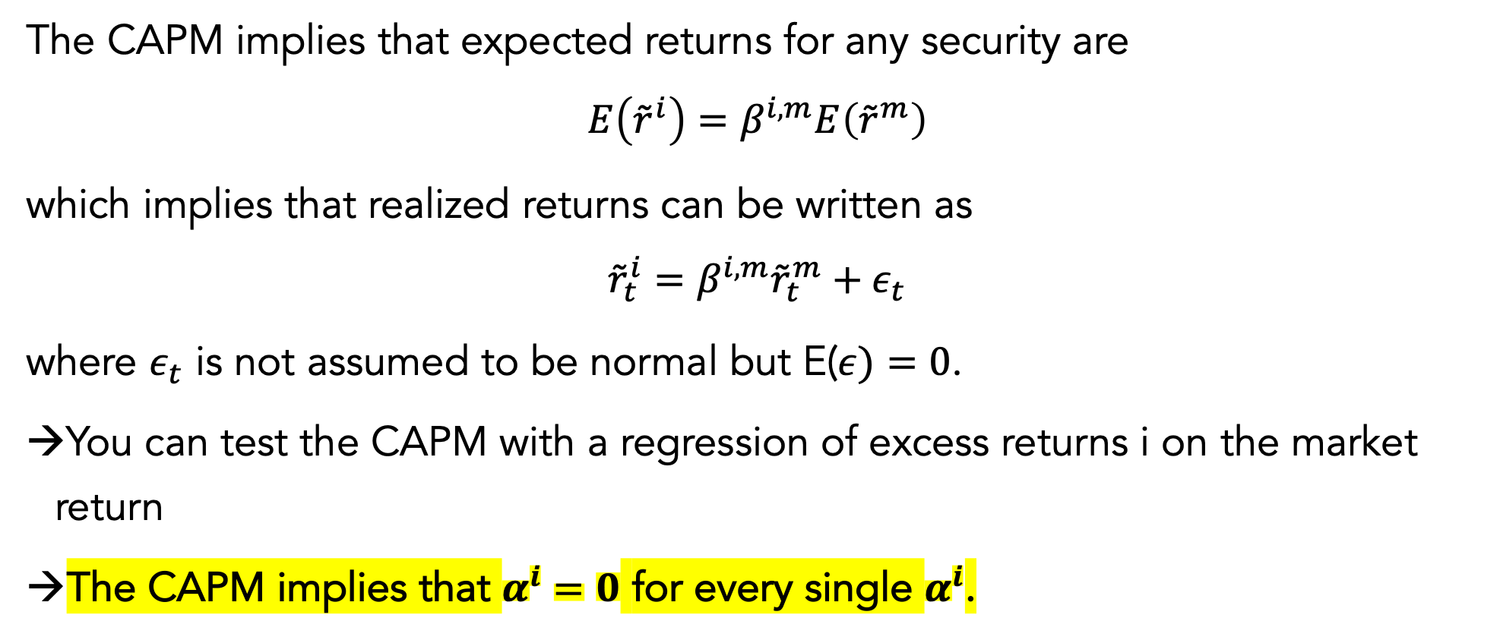
CAPM and expected vs. realized returns
The CAPM implies that expected returns for any security are
$$E\left({\tilde{r}}^{i}\right)=β^{i, m}E\left({\tilde{r}}^{m}\right)$$
which implies that realized returns can be written as
$${\tilde{r}}_{t}^{i}=β^{i, m}{\tilde{r}}_{t}^{m}+ε_{t}$$
where $ε_{t}$ is not assumed to be normal but E($ε)=0$.
You can test the CAPM with a regression of excess returns i on the market return
The CAPM implies that $α^{i}=0$ for every single $α^{i}$.

Slide 14
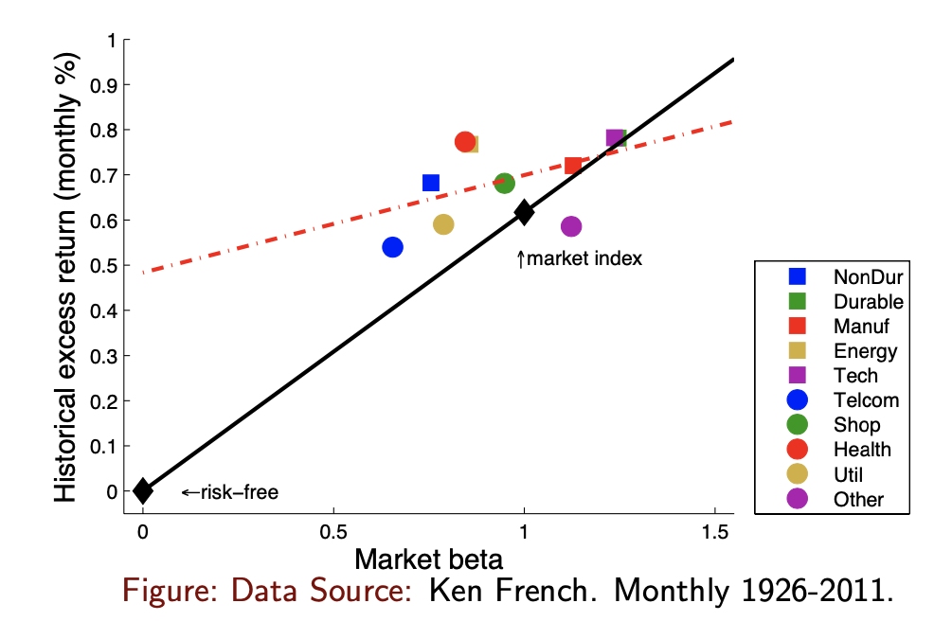
Criticism of the CAPM
The risk-reward tradeoff is too flat relative to CAPM.

Slide 15
Lecture Outline
Linear Factor Pricing Models
The CAPM
Multi Factor Models
Fama-French Model

Slide 16
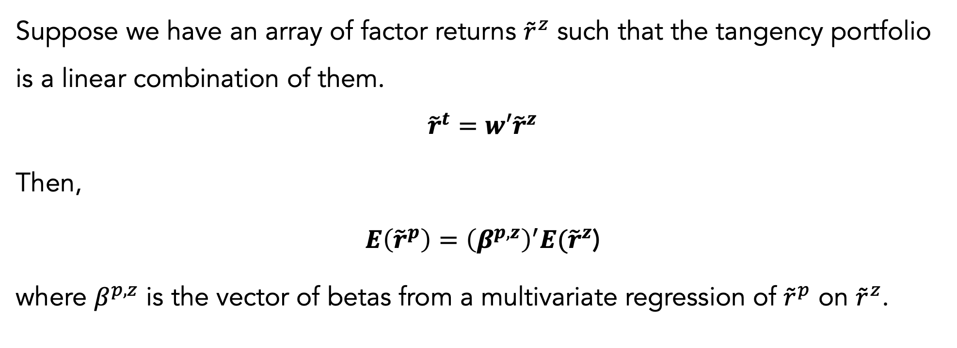
Multiple factors
Suppose we have an array of factor returns ${\tilde{r}}^{z}$ such that the tangency portfolio is a linear combination of them.
$${\tilde{r}}^{t}=w′{\tilde{r}}^{z}$$
Then,
$E\left({\tilde{r}}^{p}\right)={\left(β^{p,z}\right)}^{′}E({\tilde{r}}^{z}$)
where $β^{p,z}$ is the vector of betas from a multivariate regression of ${\tilde{r}}^{p}$ on ${\tilde{r}}^{z}$.

Slide 17
Lecture Outline
Linear Factor Pricing Models
The CAPM
Multi Factor Models
Fama-French Model

Slide 18
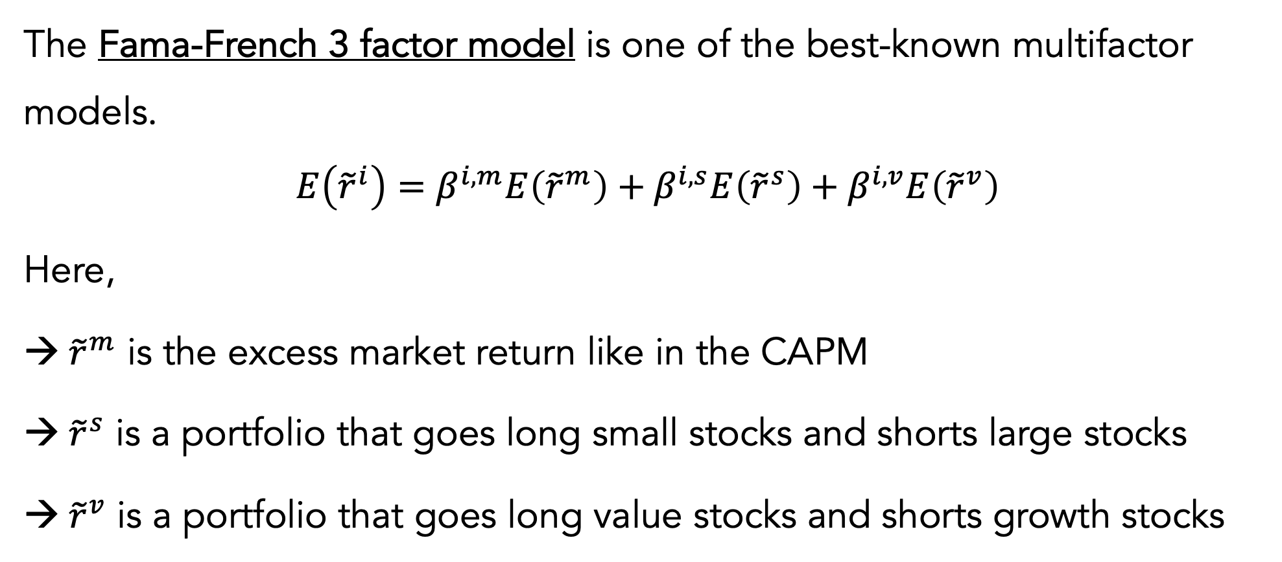
Fama-French model 💙 💙 💙
The Fama-French 3 factor model is one of the best-known multifactor models.
$$E\left({\tilde{r}}^{i}\right)=β^{i,m}E\left({\tilde{r}}^{m}\right)+β^{i,s}E\left({\tilde{r}}^{s}\right)+β^{i,v}E\left({\tilde{r}}^{v}\right)$$
Here,
${ \tilde{r}}^{m}$ is the excess market return like in the CAPM
${ \tilde{r}}^{s}$ is a portfolio that goes long small stocks and shorts large stocks
${ \tilde{r}}^{v}$ is a portfolio that goes long value stocks and shorts growth stocks

Slide 19
Use of growth and value
Historically, value stocks have delivered higher average returns.
“Value” investors try to get in on this by looking for stocks with low market price per fundamental or per cash flow.
Many funds, like ETFs, mutual funds, hedge funds, etc., identify themselves as being “value” or “growth” oriented.

Slide 20
Fama-French measure of value
The book-to-market, or B/M ratio is the market value of equity over the book value of equity.
A high B/M means the stock has strong accounting fundamentals per unit of market value.
High B/M stocks are value stocks
Low B/M stocks are growth stocks

Slide 21
Other measures of value
Earnings-price (E/P) is a popular metric. Accounting value per dollar of market valuation
EBITDA-price
Dividend-price: less used since many individual firms have no dividends
There are a gazillion other measures and many competing claims to have a special or better measure of value.

Slide 22
Other popular factors
Price movements – momentum, mean reversion
Volatility
Profitability
Investment

